Slide 1
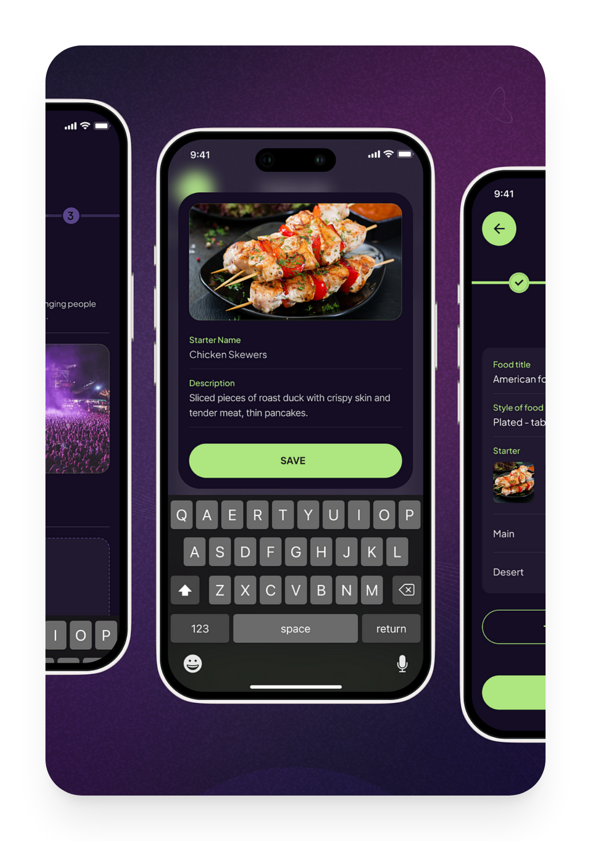
Event
Management
PHP Backend + Flutter Mobile App
Plan • Sell • Check-in • Engage
2026-02-14

Slide 2








Product Overview
Key Features
CONTENTS
UI/UX & Visual System
Table of
Contents
Mobile App (Flutter)
Backend & API (PHP)
Data & Security
Development Approach
Roadmap
Event Management App - PHP & Flutter
02

Slide 3
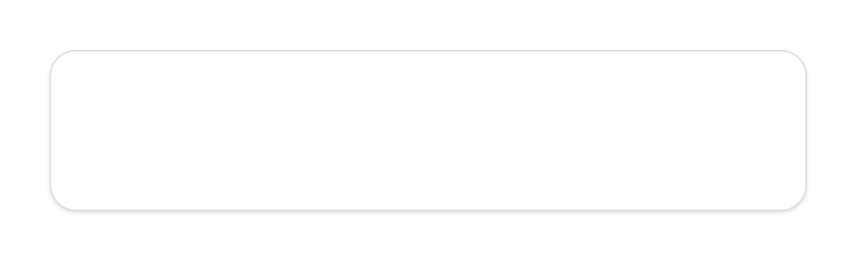
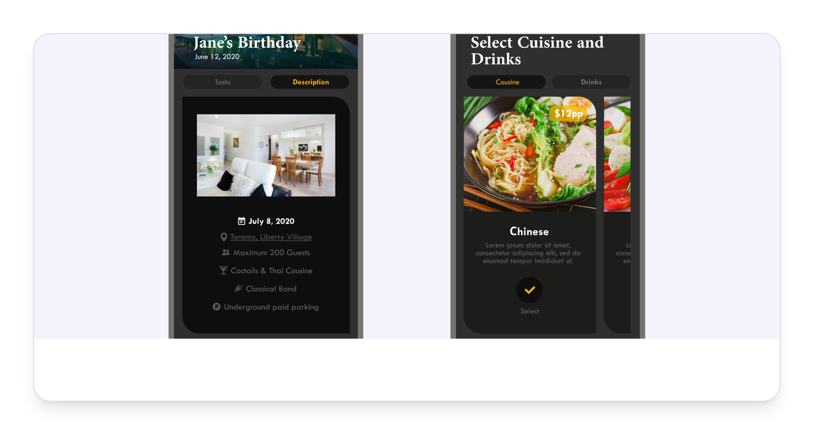
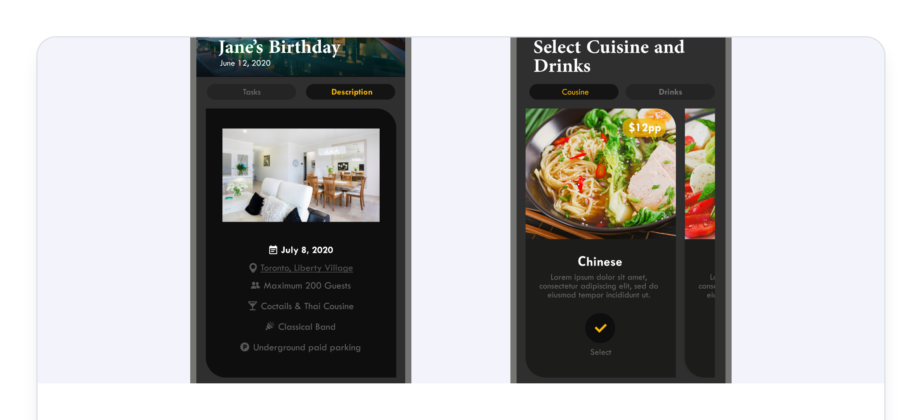


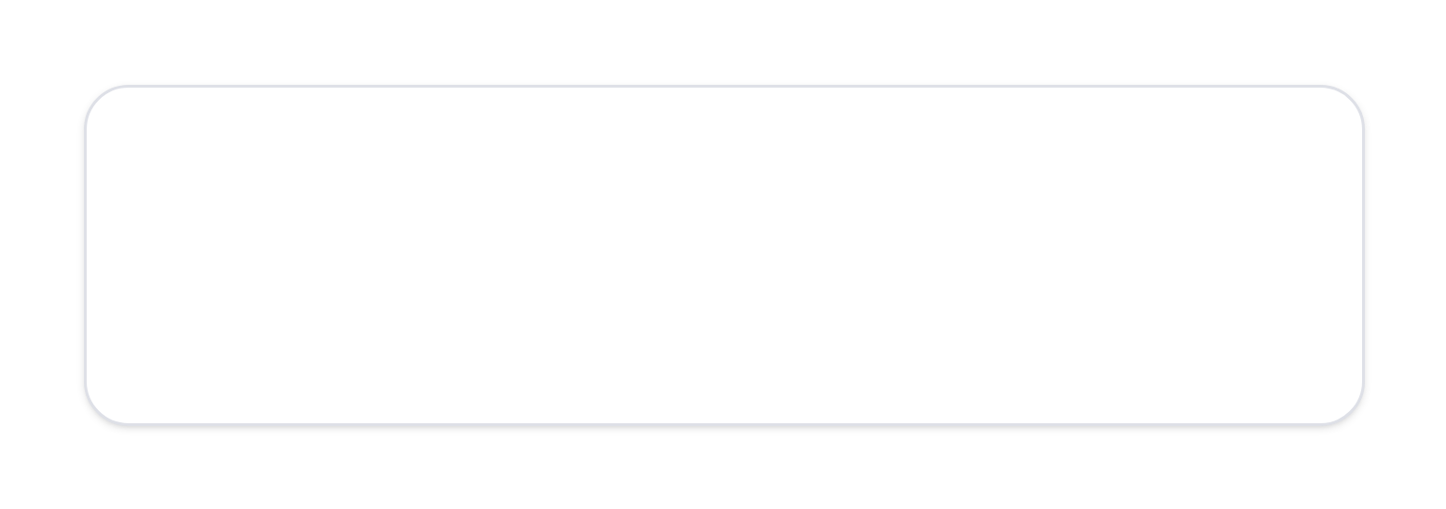













Product
Overview
An all-in-one app that streamlines the event lifecycle—from discovery to post-event reporting.
Organizers
create events, sell tickets, manage attendees
Attendees
discover events, register, access tickets, receive updates
Core Workflow
Discover/Publish
Register/Pay
Ticket (QR)
Check-in
Engage
Insights
Event Management App - PHP & Flutter
03

Slide 4











Key Features —
Organizer
Event Setup
Ticketing & Registration
Create/edit event details, agenda, venue info
Multiple ticket types (e.g., early bird, VIP)
Publish/unpublish and manage capacity
Custom registration fields (e.g., dietary, company)
Automated confirmation with QR ticket
Operations
Attendee list management, badge support (optional)
Analytics Dashboard
Real-time updates to agenda and announcements
Monitor sales & check-ins in real-time
Event Management App - PHP & Flutter
04

Slide 5

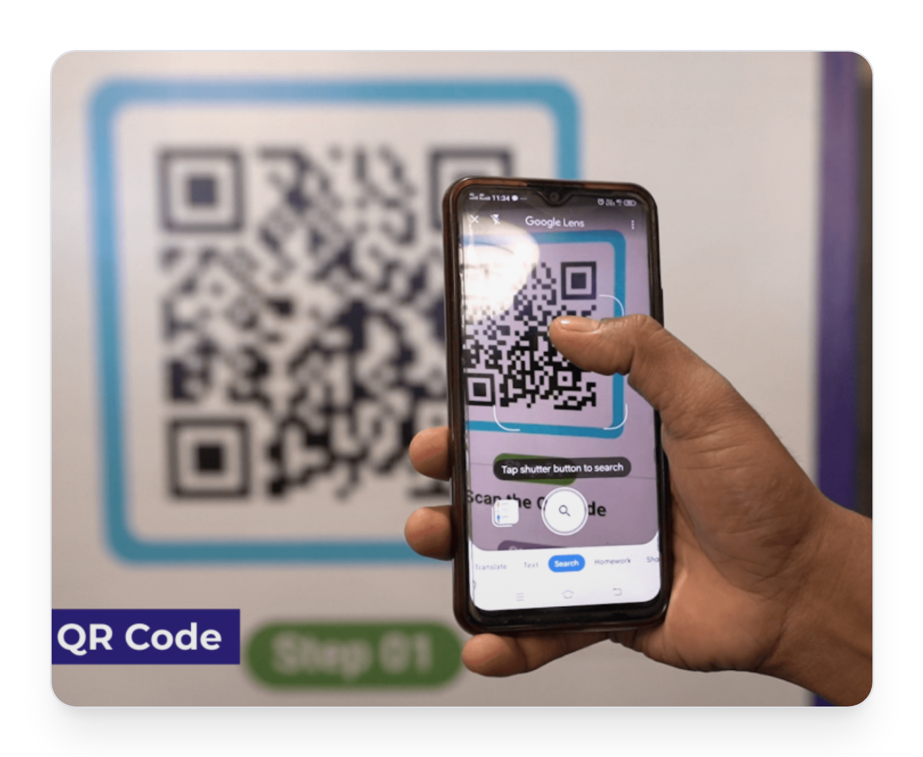
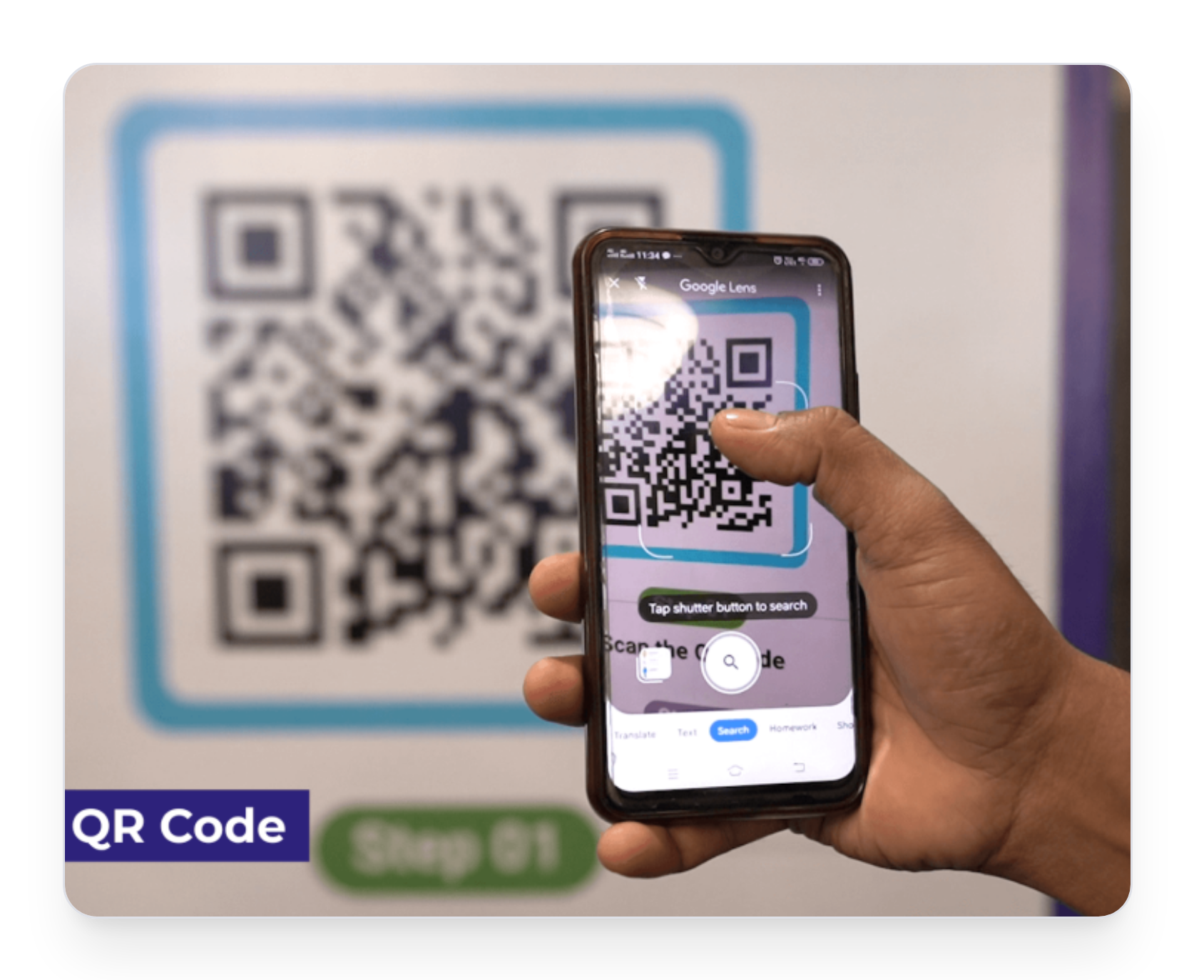





Key Features —
Attendee
Event Discovery
Browse/search events, categories, saved events
Personal Agenda
Build ‘My Schedule’, session reminders
Ticket Wallet & Check-in
In-app QR ticket, fast entry validation
Communication
Push notifications for schedule/location changes
Event Management App - PHP & Flutter
05

Slide 6

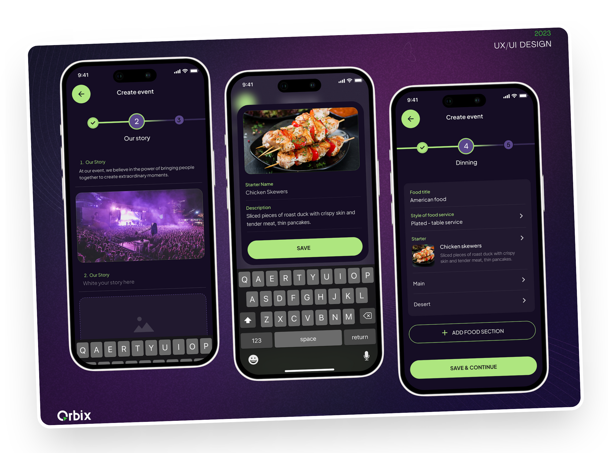

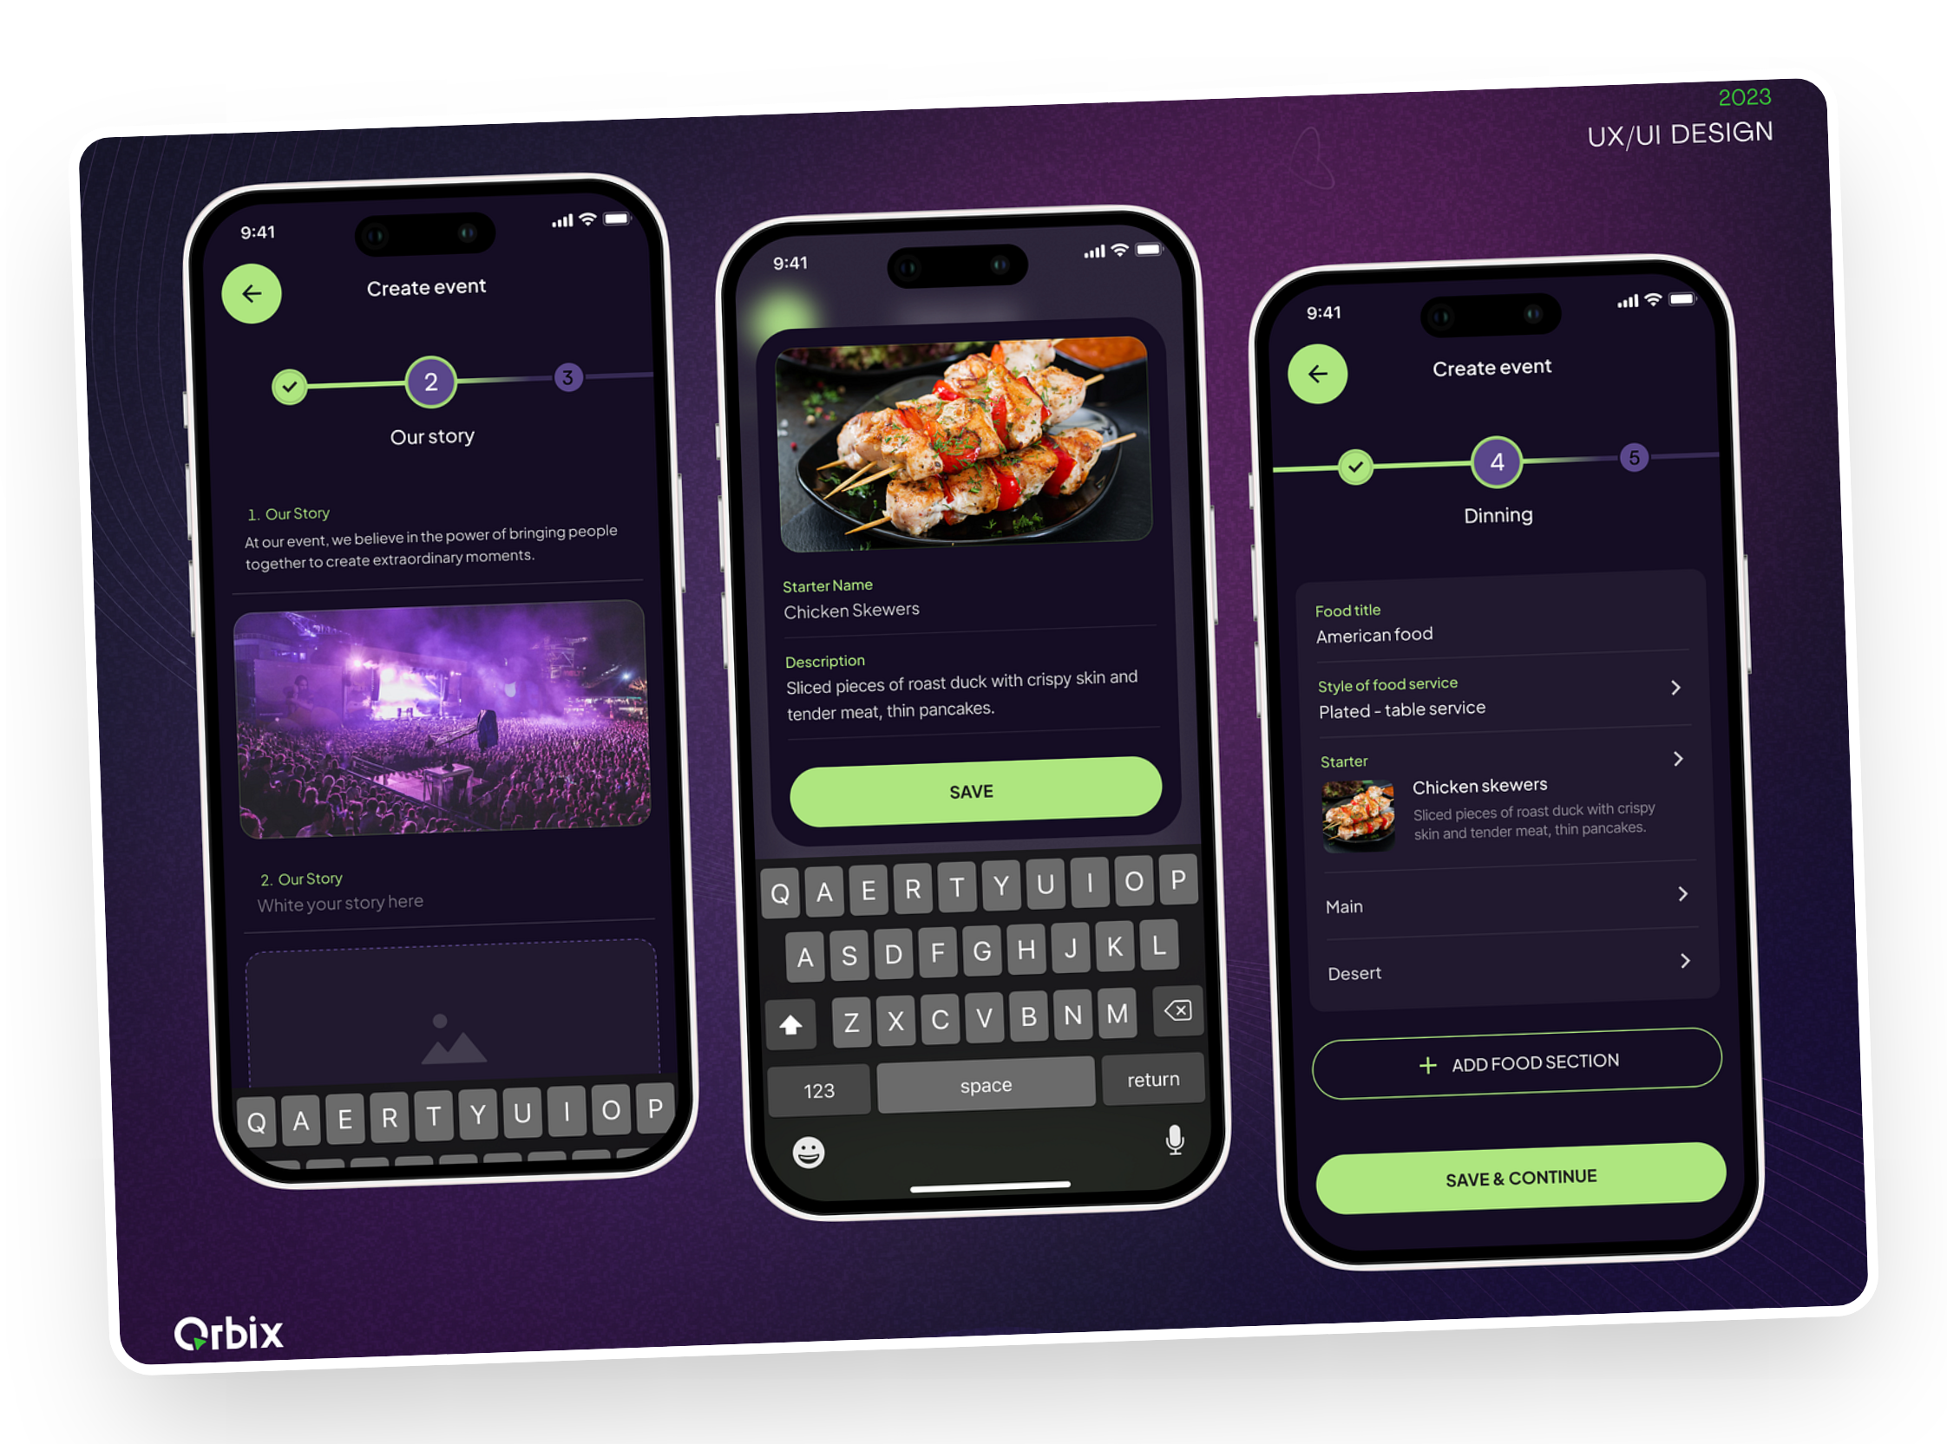
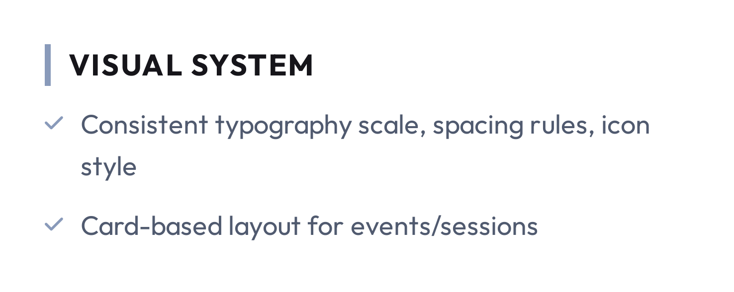
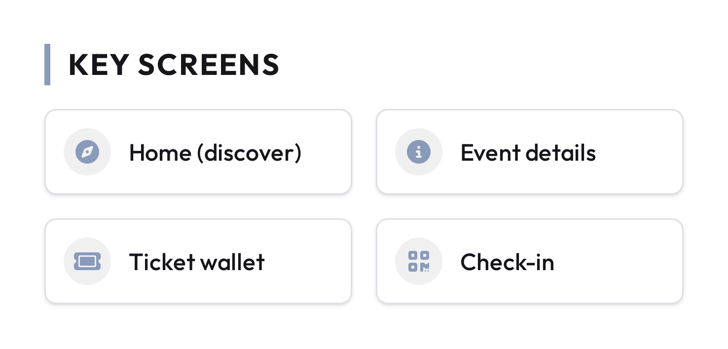




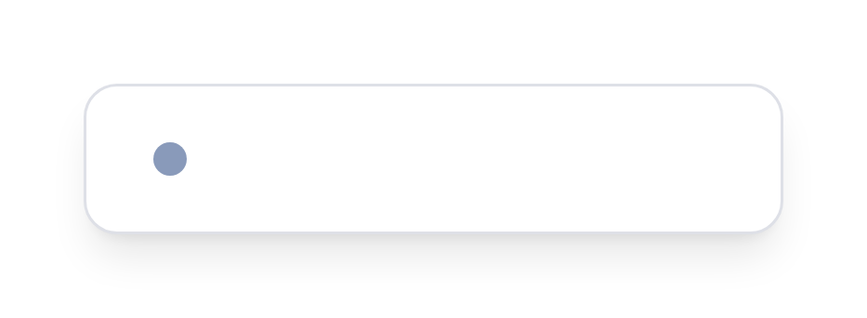
UI/UX &
Visual Design
Premium Experience
Event Management App - PHP & Flutter
06

Slide 7













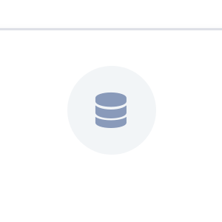

Mobile App —
Flutter Capabilities
Architecture
Presentation
Offline-friendly Experience
UI + state
Cache events/tickets locally; queue actions when offline
Notifications & Deep Links
Push alerts for agenda updates
Domain
Deep links open specific event/ticket screens
use cases
Performance
Smooth scrolling lists, image optimization, responsive layouts
Data
API + local cache
Event Management App - PHP & Flutter
07

Slide 8

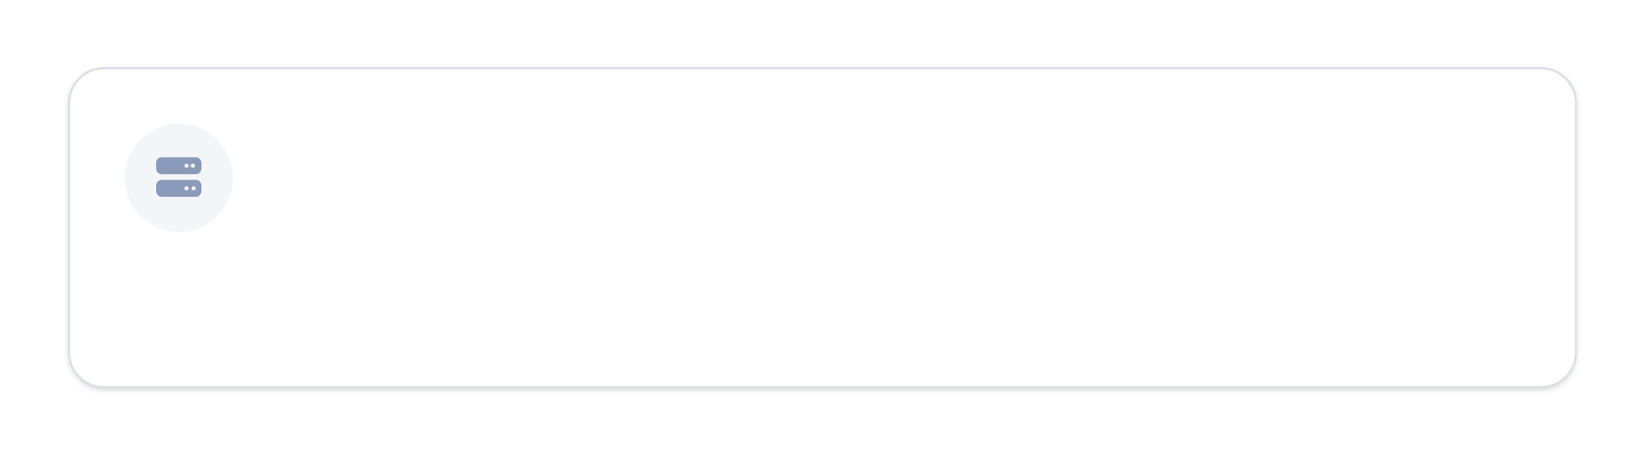
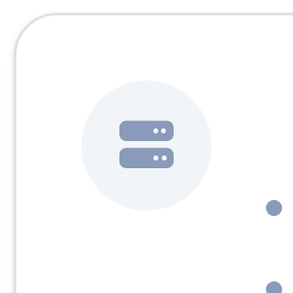


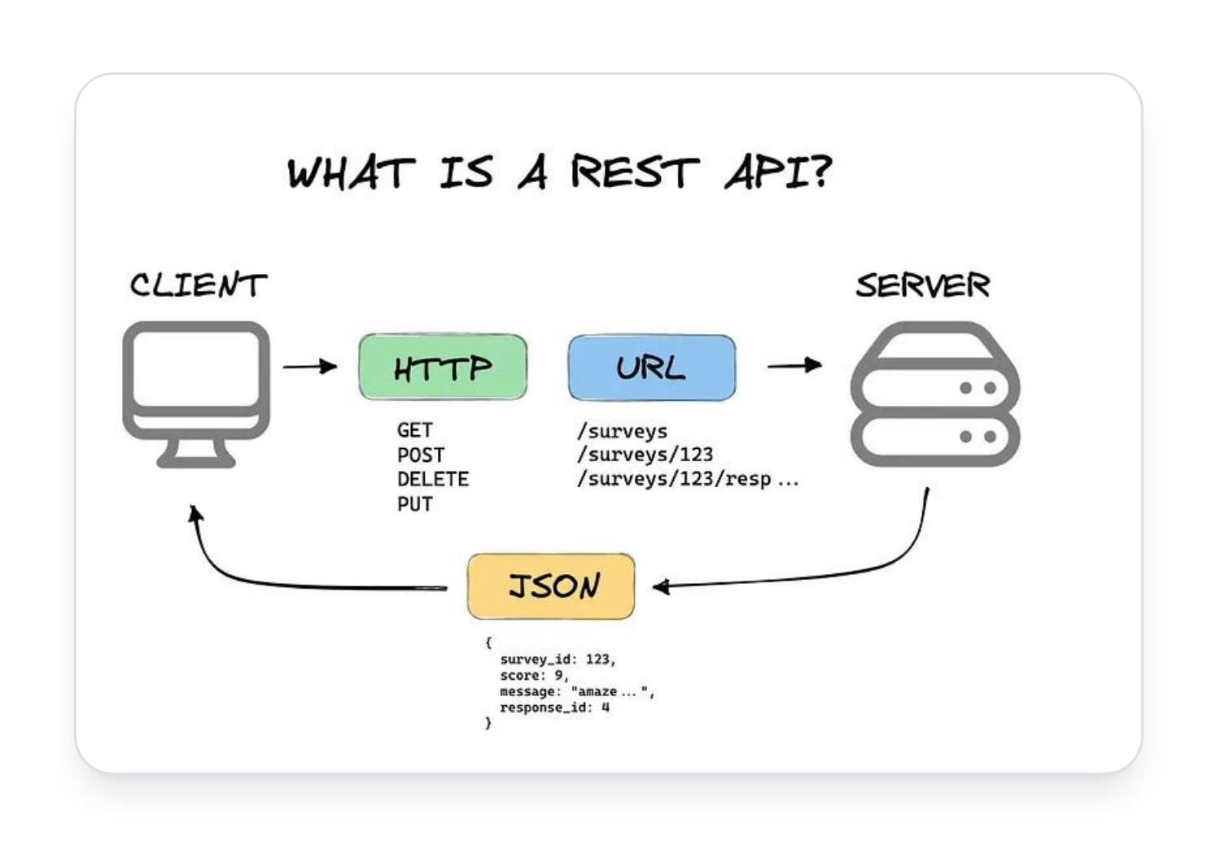
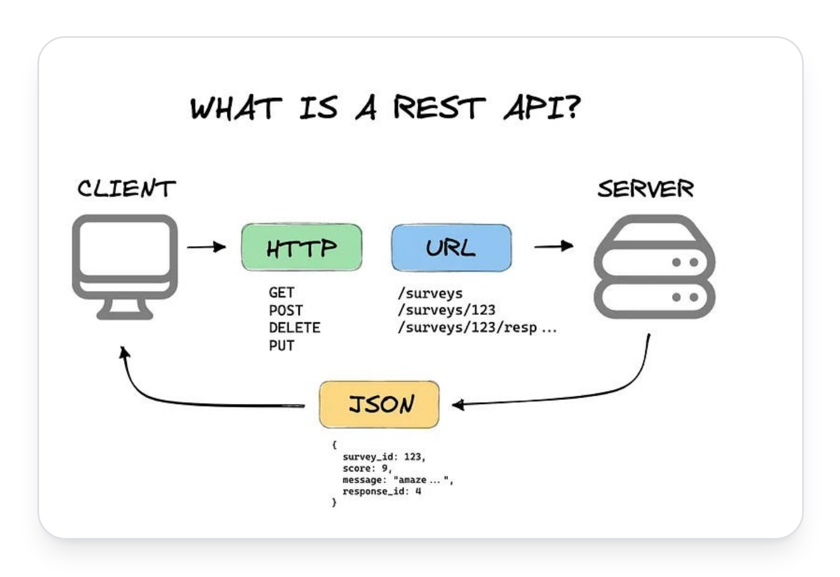
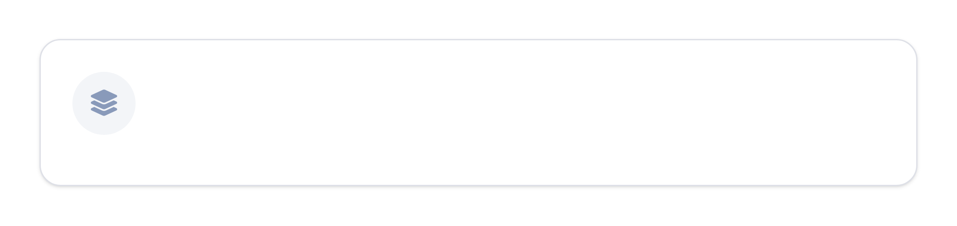


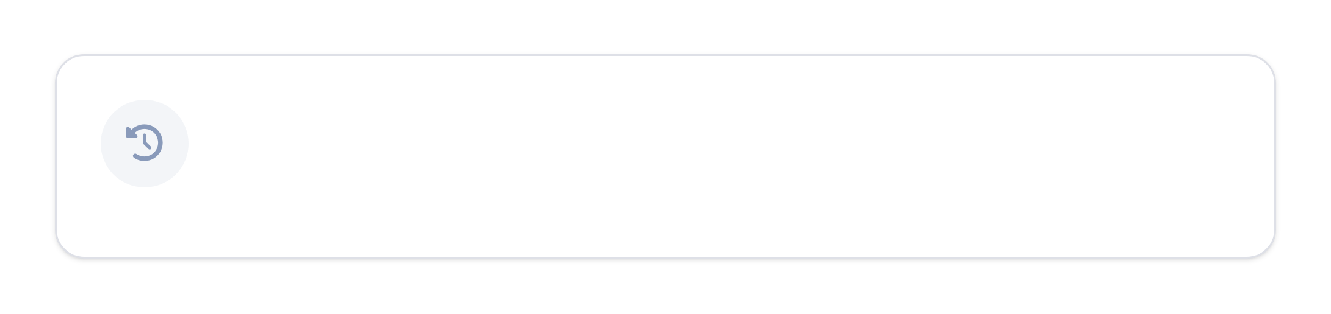



Backend & API —
PHP
API-First Design
REST endpoints for events, tickets, registrations, check-ins
Versioning strategy (e.g., /api/v1)
Clean Separation
Controllers + Services + Resources/Transformers
Architecture Reference
Async Work
Events/Listeners for email confirmations and notifications
Event Management App - PHP & Flutter
08

Slide 9


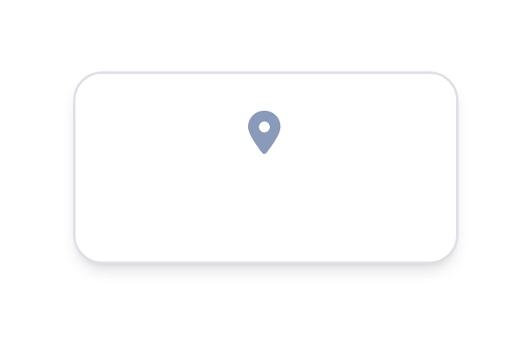





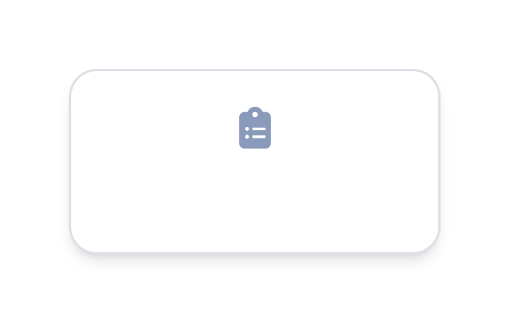




Data Model &
Security
Security Baseline
Users
Venues
JWT-based authentication for secure API calls
Role-based access (organizer/admin vs attendee)
Standard protection: HTTPS, input validation, rate limiting
Events
Reliability
Comprehensive audit logs for check-ins
Registrations
Tickets
Idempotent check-in endpoint to avoid duplicates
Core Entity Relationship Model
Event Management App - PHP & Flutter
09

Slide 10








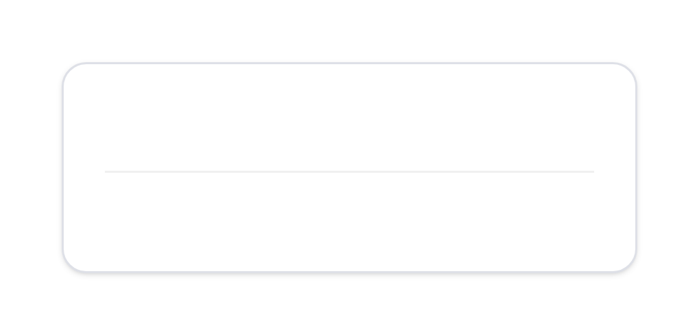
Development
Approach
Build fast with reusable components while keeping the system testable and maintainable.
UI & Frontend
API & Backend
Release
UI prototyping → Flutter implementation
API design → PHP implementation
Integration & QA → release
CI for build + unit tests
Reusable UI components, design tokens
API documentation and contract testing
Event Management App - PHP & Flutter
10

Slide 11



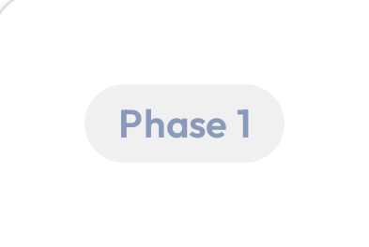
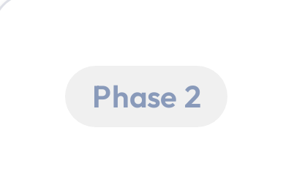
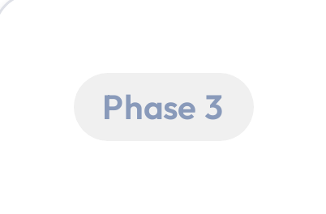







Roadmap &
Next Steps
Near-term
Mid-term
Future
Ticketing + QR check-in MVP
In-app agenda personalization + reminders
Exhibitor lead capture
Organizer dashboard + attendee ticket wallet
Advanced engagement (polls, Q&A)
Analytics dashboard and exports
Next Step
Confirm MVP scope and begin UI prototype + API contract.
Event Management App - PHP & Flutter
11

Slide 12


Thank You
Simplify planning. Elevate every event.
Contact us for more details
contact@eventapp.com

